Slide 1
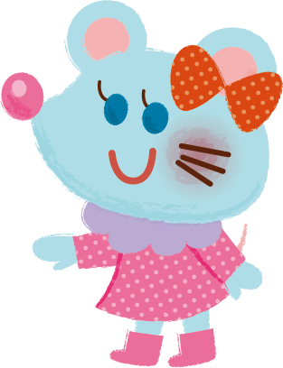
Wishing you a new year
filled with new hope.

