Slide 1

7 most-used
Excel functions

Slide 2
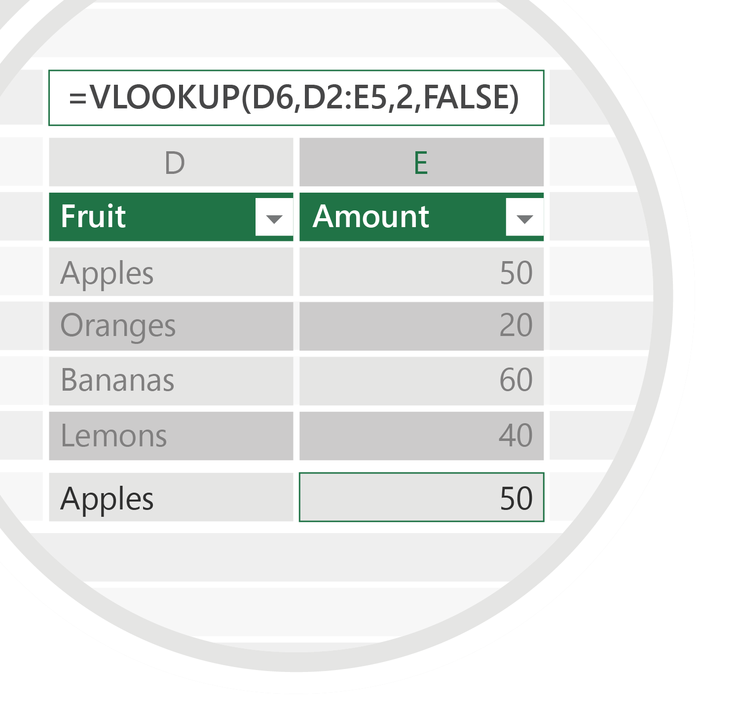

VLOOKUP
1
Use it to look up and
retrieve data from a table.
Syntax
VLOOKUP (lookup_value, table_array, col_index_num, [range_lookup])

Slide 3
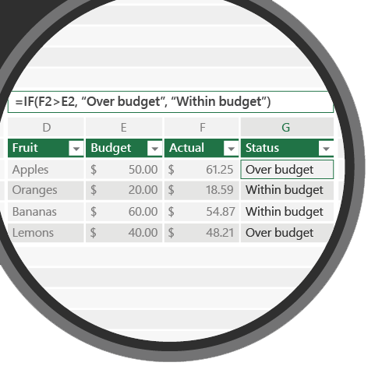

IF
2
Use it to make comparisons between a
value and what you expect.
Syntax
IF(logical_test, value_if_true, [value_if_false])

Slide 4
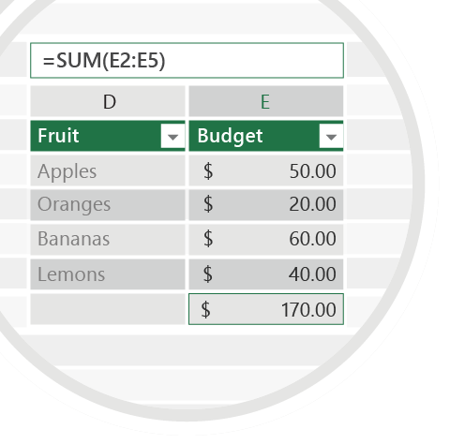
SUM
3
Use it to add up a range
of numbers.
Syntax
SUM(range to be summed)

Slide 5
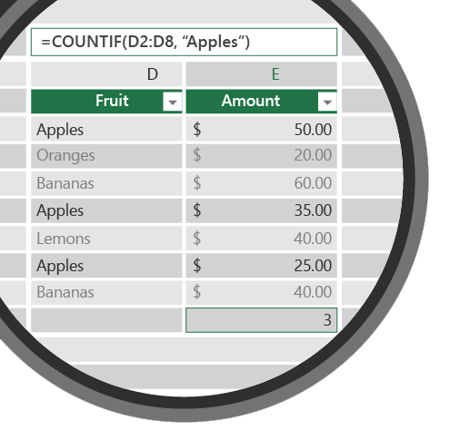
COUNTIF
4
Use it to count the number of cells that meet a criterion.
Syntax
COUNTIF(range, criteria)

Slide 6
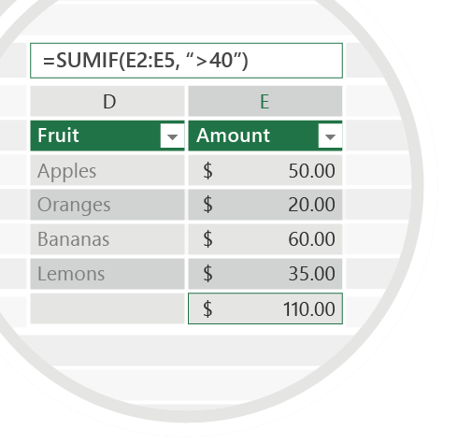
SUMIF
5
Use it to sum the values
in a range that meet specific criteria.
Syntax
SUMIF(range, criteria, [sum_range])

Slide 7
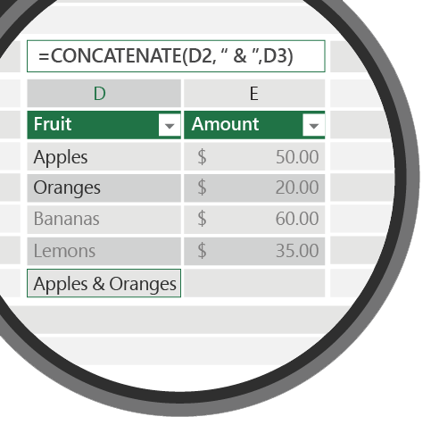
CONCATENATE
6
Use it to join two or more text strings into one string.
Syntax
CONCATENATE(text1, [text2], …) To add spaces or punctuation, type the item in quotation marks between the cells or values you want to connect.

Slide 8
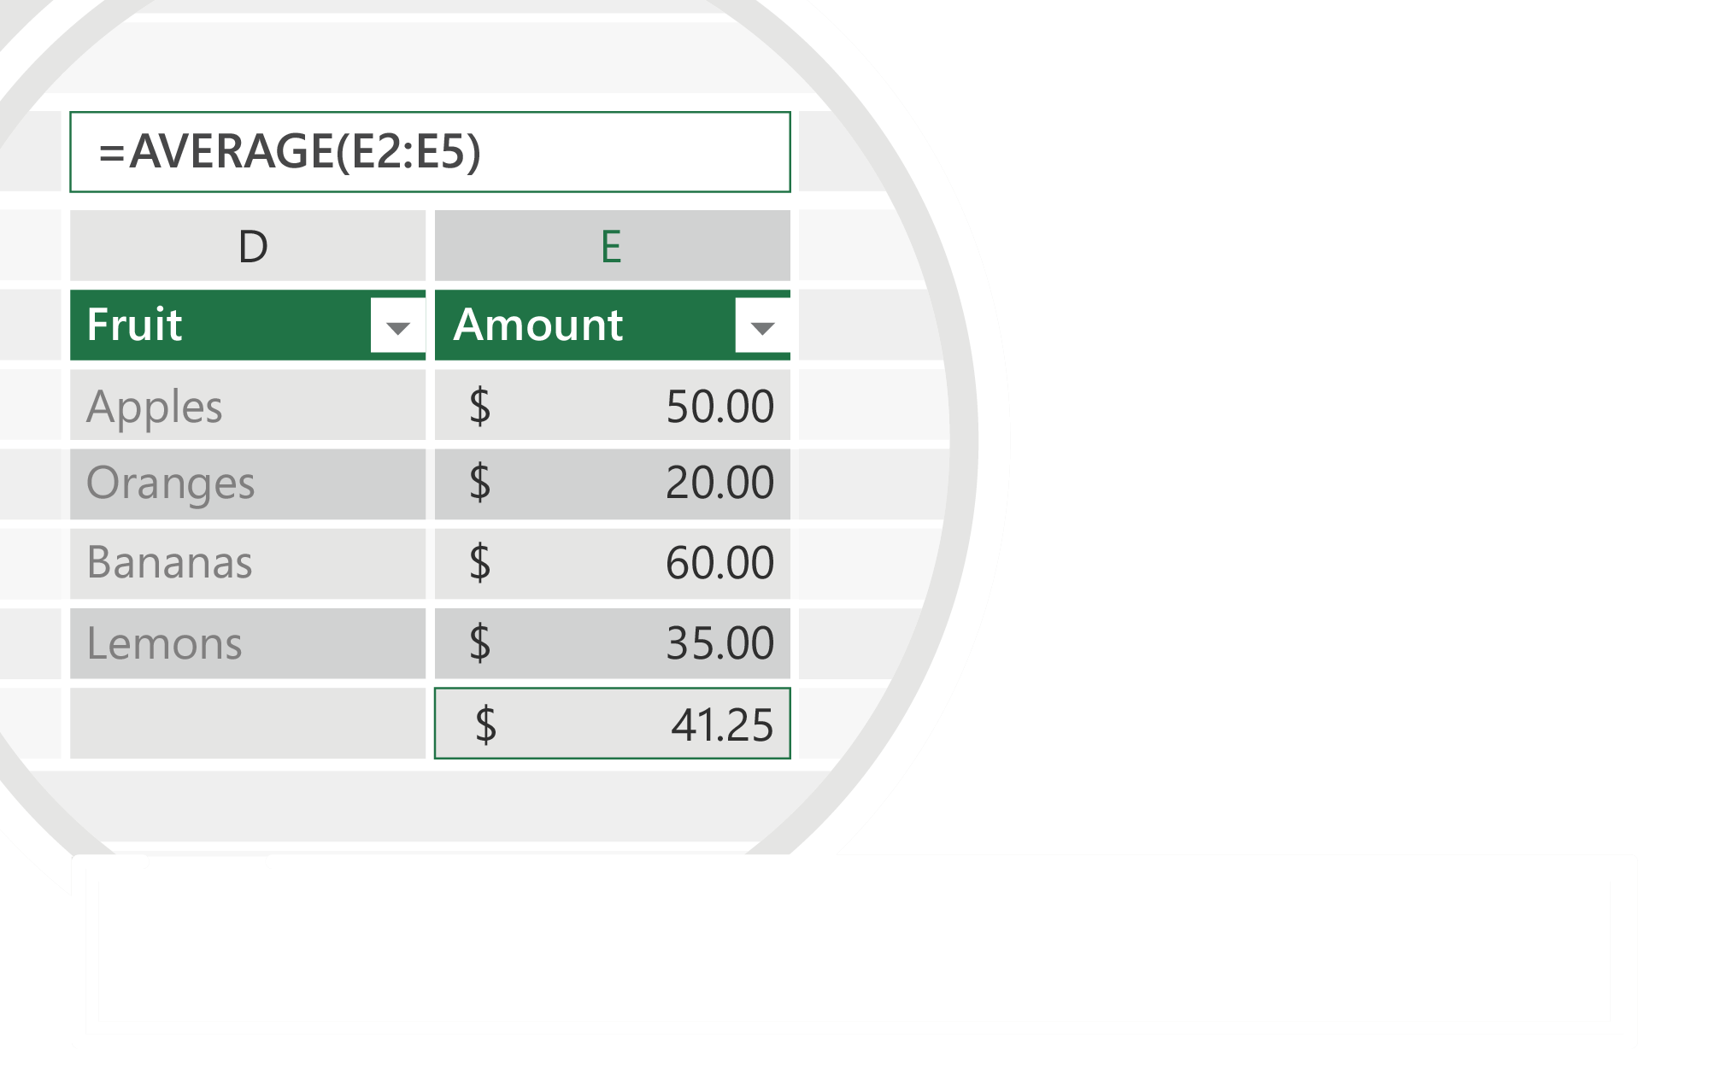
AVERAGE
7
Use it to return the average of a range of
numbers.
Syntax
AVERAGE (number1, [number2], …)
For more information, visit aka.ms/ExcelTips

